Slide 1
Graphical abstracts
Krista Mitchnick
June 3, 2021
Notes:
GA’s appeared in social science journals in 2010 and have seen over a 350% increase from 2011-2015 (Yoon & Chung, 2017)
Appeared slightly earlier in the hard sciences and engineering, and is more often used in those fields.
Elsiveir’s The Article of the Future project “aim[s] to revoutionize the traditional format of the academic paper.” The project has developed discipline-specific prototypes which enhance navigation and browsing, add content (e.g., interactive tables, figures, and maps, graphical abstracts, etc.), and provide context (e.g., related information, related articles, etc.). The Graphical Abstract (GA), which utilizes visual information as an abstract, is a part of the project.

Slide 2
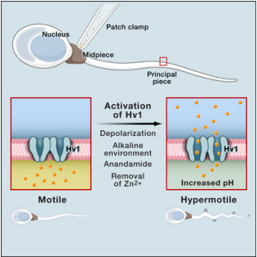
What is a Graphical abstract?
(Hullman & Bach, 2018; Yoon & Chung et al., 2017; Elsevier Publishing)
“single, concise, pictorial and visual summary of the main findings of the article”
Notes:
It’s more or less a summary diagram. You might not be able to have all of the effects, but you should have the main effects.
They usually do not appear in the pdf download or print article, only online and in search results.

Slide 3
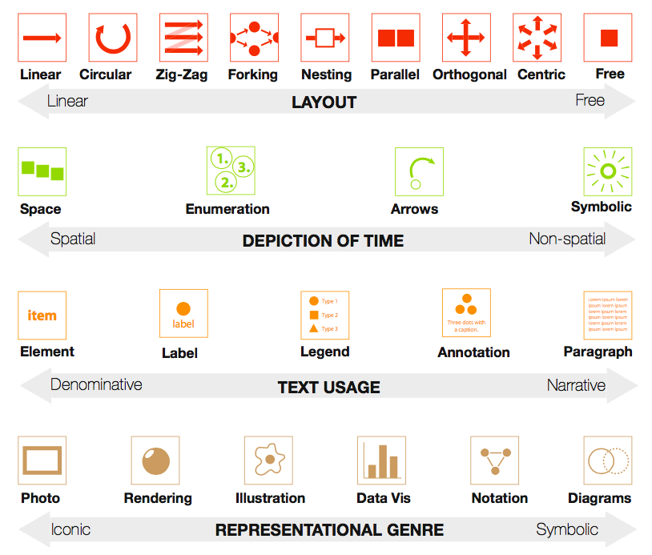
Design Elements
Schemas
(Hullman & Bach, 2018)
Notes:
Did not include colour because was not related to content.
Representational genre – based on iconicity: icons specific real life vs. symbols
Often displays contained multiple types of representations

Slide 4


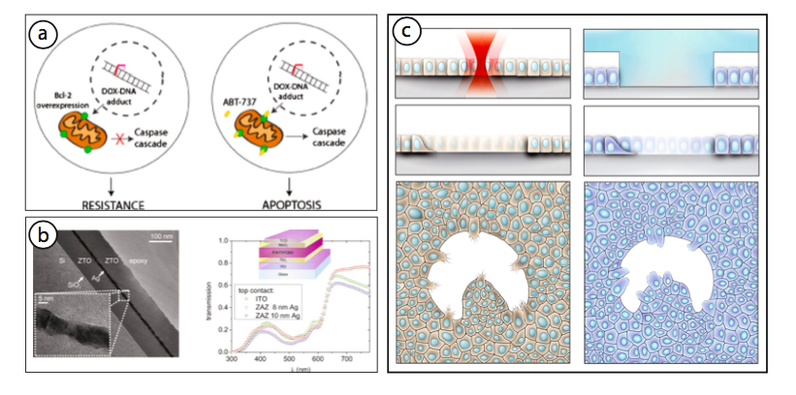


Slide 5
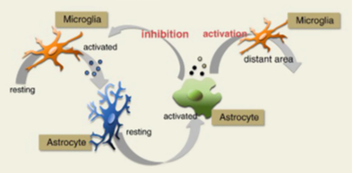
Design Elements
Schema
Schemas
(Hullman & Bach, 2018)
Notes:
Schematic elements can span an entire GA, effectively turning the entire GA into a schema.
More than other genres, schemas employ layout devices that help convey the logic behind the depiction (e.g., linear to denote a process, parallel to denote alternatives, etc.).

Slide 6
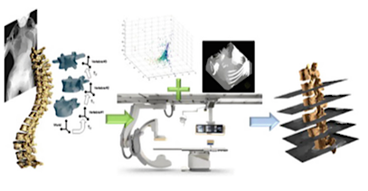
Ambiguity:
Unclear priority - Use of vertical and horizontal space often lack clear visual cues to prioritize one of the dimensions to the reader
Unclear reading order - Very difficult when you have multi-directions and are trying to display something over time
Time best depicted horizontally
Unclear priority
(Hullman & Bach, 2018)

Slide 7
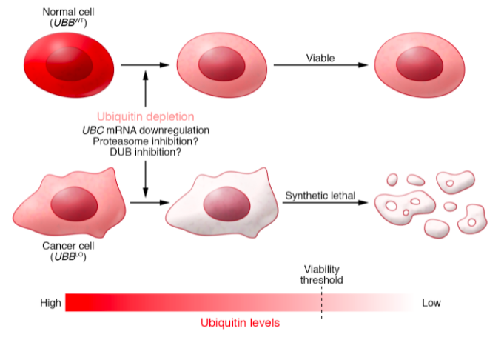
Ambiguity:
Unclear relationships between pictures
Missing annotations
Inconsistent visual styles
(Hullman & Bach, 2018)
Notes:
Unclear relationships between pictures make it ambiguous whether multiple pictures refer to a natural, temporal sequence, or a methodology based on human intervention, or whether they represented equal alternatives.
Missing annotations make it hard to explain and interpret visual elements in illustrations or pictures, including data visualizations.
Inconsistent visual styles for text and graphical elements raise questions about whether the differences are intended to convey information or are arbitrary.

Slide 8
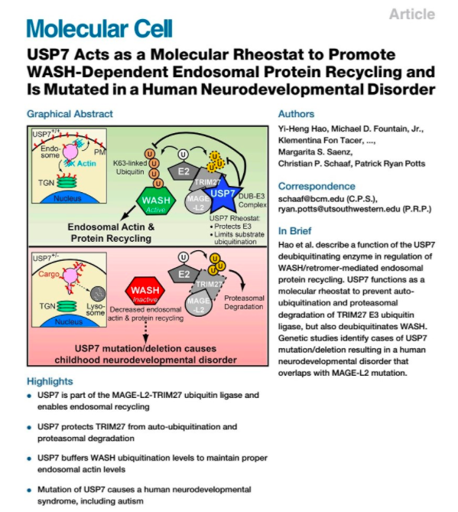
Abstracts for all different learning sTyles?
Notes:
When verbal and visual techniques are combined to convey information, attention, understanding, and recall of the information are enhanced.
Mayer’s (2005) cognitive theory of multimedia learning - verbal and visual presentations, which enter the mind through sensory memory, are processed through selection, organization, and integration processes. (based off of Dual Coding theory Paivo).

Slide 9
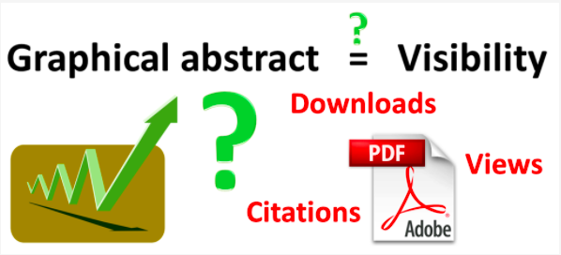
Are graphical abstracts effective?
Pferschy-wenzig et al., 2016. Molecules

Slide 10
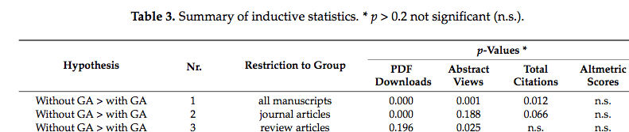
Are they effective?
Pferschy-wenzig et al.,
2016. Molecules
Notes:
Articles in the journal Molecules from 2014-2015
One potential explanation might be that GA are more often used by younger scientists who have high affinity to social media. In contrast, more well-established scientists might be less familiar with this rather recent tool, or may be less interested in investing extra work into the preparation of a GA. It is quite likely that articles published by more renowned scientists raise more interest and are more frequently cited, viewed, and downloaded.
Another way of explaining this finding could be the direct effect of a well-designed GA which gives the observer a concise idea of the content of the paper and thus makes an explicit abstract view or paper download superfluous. This point of view would suggest that papers with GA might receive fewer but better targeted downloads.

Slide 11
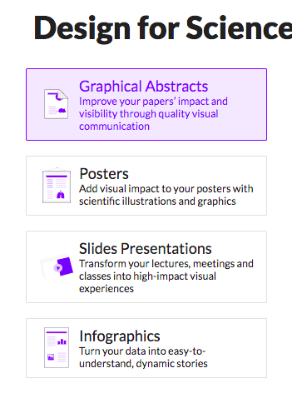
Mindthegraph.com
Notes:
https://mindthegraph.com/?gclid=Cj0KCQjw2NyFBhDoARIsAMtHtZ7vuGSzsFFuj4iz5dur-HciIxJLJl8SyrhXLjQaVlK590Mhawpz4XAaAhg0EALw

